Slide 1



The Technology Value Stream
Understanding Lead Time, Processing Time, and Deployment Lead Times in DevOps
Erik Hernandez
Professor Sue Sampson
06/02/2024

Slide 2
Introduction
Overview:
The Technology Value Stream represents the series of steps an organization uses to create and deliver a product or service to its customers. This presentation focuses on key metrics within the value stream: Lead Time, Processing Time, and Deployment Lead Times, and explores their impact on software development processes.
Purpose:
To define and differentiate between Lead Time and Processing Time.
To understand the challenges associated with long deployment lead times.
To explore the DevOps ideal of achieving rapid deployment lead times.

Slide 3
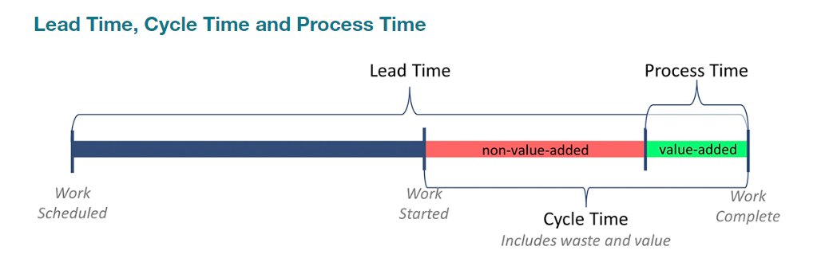
Defining Lead Time v. Processing Time
Lead Time:
The total duration from when a request is made to when it is fulfilled. This includes both processing and waiting times.
Processing Time:
The actual time spent working on a task. This is a subset of Lead Time, excluding any waiting periods.
Citation:
Textbook, Page 9

Slide 4
Example of Lead Time and Processing Time
Scenario:
Consider a software development task such as adding a new feature.
Lead Time:
Request to Implementation: 10 days
Approval & Waiting: 5 days
Processing: 5 days
Processing Time:
Actual coding and testing: 5 days

Slide 5
The Common Scenario: Deployment Lead Times Requiring Months
Description:
In many traditional development environments, deployment lead times can extend over several months due to various inefficiencies.
Factors:
Manual Processes: Extensive manual steps in testing and deployment.
Complex Approvals: Multiple layers of approvals and sign-offs.
Lack of Automation: Minimal use of automated testing and deployment tools.
Impact:
Productivity: Slower delivery reduces team productivity.
Responsiveness: Delays in deploying updates and fixes.
Customer Satisfaction: Longer wait times for new features and bug fixes.
Citation:
Textbook, Page 10

Slide 6
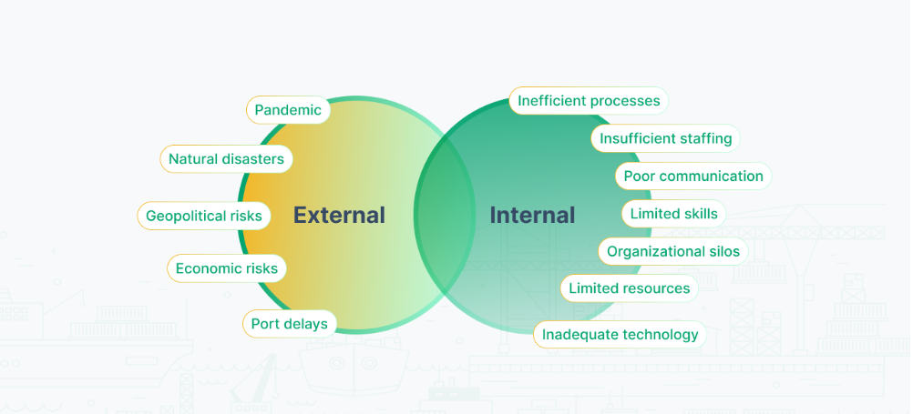
Challenges with Long Deployment Lead Times
Challenges:
Delayed Feedback: Longer cycles delay feedback from users.
Increased Risk: Higher risk of defects and integration issues.
Decreased Competitiveness: Slower time-to-market affects competitiveness.

Slide 7
Our DevOps Ideal: Deployment Lead Times of Minutes
Description:
The DevOps ideal aims for deployment lead times of minutes, leveraging continuous integration and continuous delivery (CI/CD) practices.
Practices:
Continuous Integration: Regularly integrating code changes into a shared repository.
Continuous Delivery: Automating the deployment process to ensure code can be reliably released at any time.
Automation: Automating testing, integration, and deployment processes.
Benefits:
Faster Feedback: Immediate feedback on code changes.
Higher Quality: More frequent releases improve code quality.
Increased Agility: Ability to quickly respond to market changes.
Citation:
Textbook, Page 10

Slide 8
Achieving the DevOps Ideal
Strategies:
Adopt DevOps Practices: Embrace CI/CD and DevOps culture.
Automate Everything: Focus on automation of testing, integration, and deployment.
Improve Collaboration: Enhance collaboration between development, operations, and other stakeholders.
Examples:
Infrastructure as Code: Managing infrastructure through code to ensure consistency and repeatability.
Automated Testing: Implementing comprehensive automated testing suites to catch issues early.

Slide 9
Case Study / Real World Example
Case Study
Amazon, which successfully reduced its deployment lead times using DevOps practices.
Results:
Deployment Frequency: Thousands of deployments per day.
Lead Time: Reduced from months to minutes.
Quality: Increased software reliability and customer satisfaction.

Slide 10
Conclusion
Key Points:
Defined Lead Time and Processing Time.
Discussed the common scenario of long deployment lead times and their negative impacts.
Explored the DevOps ideal of achieving deployment lead times of minutes through CI/CD and automation.
Future Outlook:
Continuous Improvement: The focus will remain on continuously improving deployment processes.
Advanced Automation: Future trends include more sophisticated automation tools and practices.
AI and Machine Learning: Incorporating AI and machine learning to predict issues and optimize workflows.
Increased Collaboration: Greater emphasis on cross-functional teams and collaborative cultures to enhance efficiency and innovation.

Slide 11
references
https://www.kaufmanglobal.com/glossary/lead-time/
https://www.cargoflip.com/post/supply-chain-bottlenecks

